Slide 1

COFFEE MACHINE PROJECT

Slide 2

FILE OF COFFEE.C
In the file of the coffee.c we divided into three voids in order to create a menu and connect with the switch – cases. In addition to that, there is an integer to take input from the user for the connected menus ‘ Hot – Cold – Exit’ and there is an if statement in order to control the input which is taken from the user

Slide 3

FILE OF EXIT.C
It is a simple design that was created with UNIX library with the commands of ‘Figlet – Sleep – Clear’.

Slide 4

FILE OF COLD.C
In the file of cold.c we divided into 6 functions
- Printing_Menu
- addBlanace
wrong_money_number
- isSizeValid
- Moneyprocces
-PrepareandServeCoffee

Slide 5
FILE OF HOT.C
In the file of hot.c we divided into 6 functions
- Printing_Menu
- addBlanace
wrong_money_number
- isSizeValid
- Moneyprocces
-PrepareandServeCoffee

Slide 6
FUNCTION OF Printing_Menu
The sizes of the coffees are divided into the 3 sizes which are Small, Medium, and Large in that function we show the user the sizes after choosing the coffee.
In that case, we used If and else statements to equal the sizes.

Slide 7
FUNCTION OF addBalance
There are variables inside of the addBalance function for instance we used credit – price calculate – addBalance with the float variable.
In that case, the user can see their own balance and another thing is the user also can see how much credit he/she should add inside of the machine
In addition to that, we connected addBalance function with another place in order to add money to the insufficient balance.

Slide 8

FUNCTION OF wrong_money_number
We designed a code that in order the block the user to not adding coins than 0.5 – 1 – 2 – 5.
We coded a simple If statement for this part.

Slide 9
FUNCTION OF isSizeValid
In that function, we created a simple if-else statement in order to take an input from the users for the sizes of the coffees.
We used pointers in the if-else statement in order to call size. In addition to that, another opportunity of the pointer is size is not related to only one option.

Slide 10

FUNCTION OF Moneyprocces
In that function, we created a do-while loop.
In The First, If statement: If the taken input from the user is less than the price of the coffee we called the addBalance function
In the Second If statement: if the taken input from the user is equal to the price of the coffee we used the calcualte2 variable with the pointer and we equal the calculate2 to 0 and then we used it to continue the preparation of the coffee
In the Third and last if statement: if the taken input from the user is more than the price of the coffee we used calculate2 with the pointer and create a simple mathematic in order the give the change to user

Slide 11

FUNCTION OF PrepareandServeCoffee
In that function, we created size from char and calculate it from the float. We called these two variables with the pointers.
Inside of the function with the printf we showed the preparation and wait for the user with sleep command which is coded by UNIX library

Slide 12
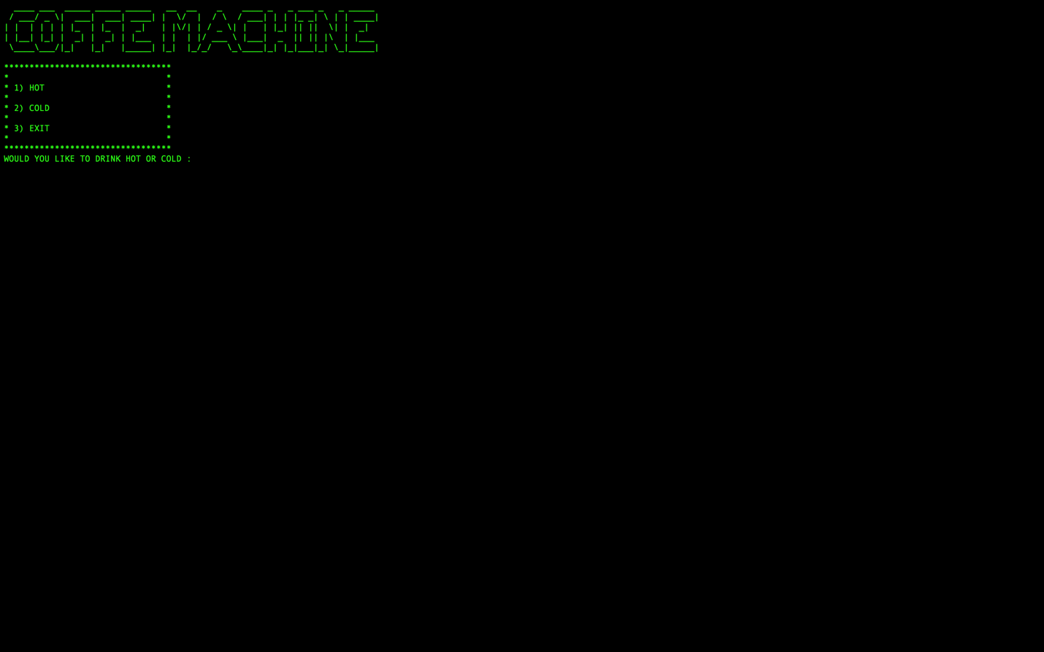
HOW DOES IT WORKS
Initially the user see the main menu according to the decision of the user the menu divided into 3 categories which are HOT COLD and EXIT

Slide 13
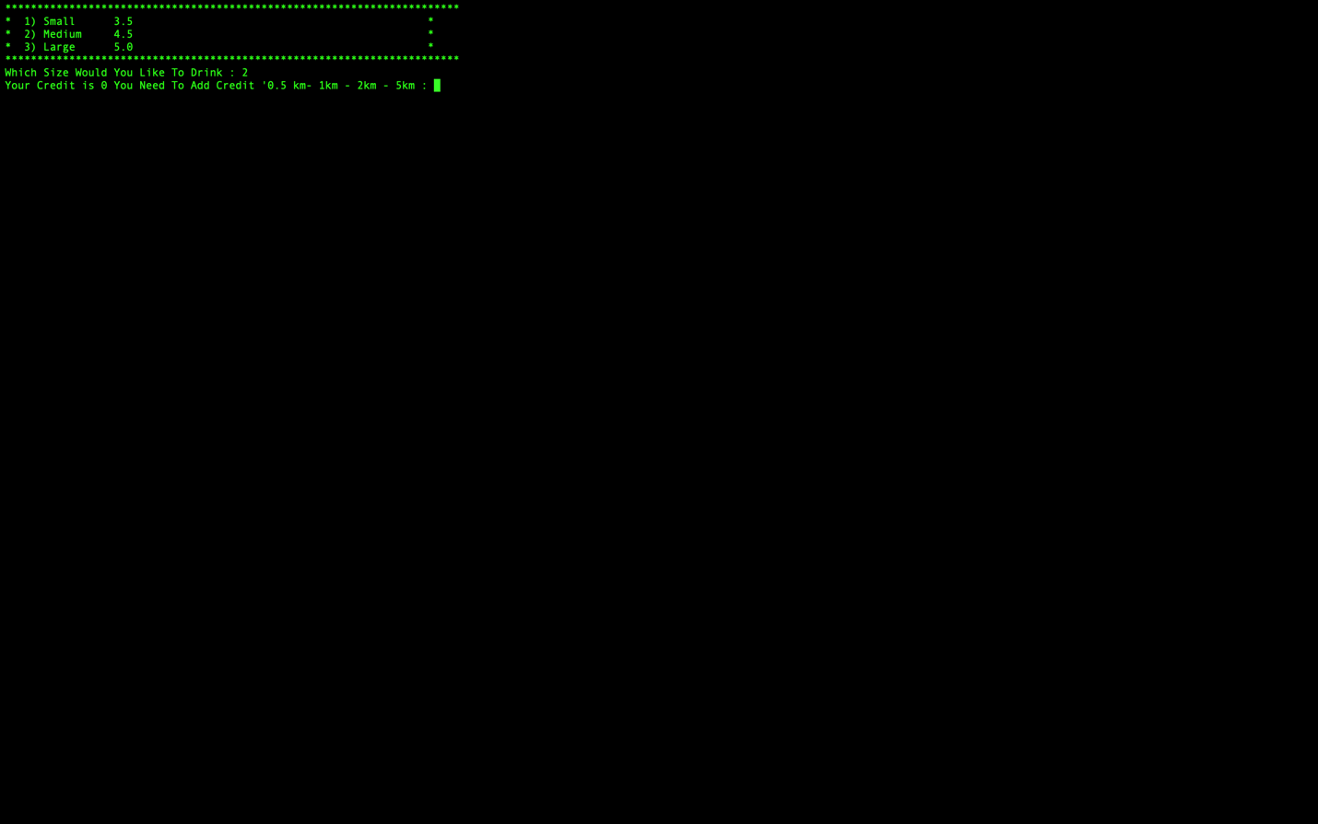
HOW DOES IT WORKS
For instance, if the user chooses hot chocolate, this menu also divided into 3 choice
SMALL
MEDIUM
LARGE

Slide 14
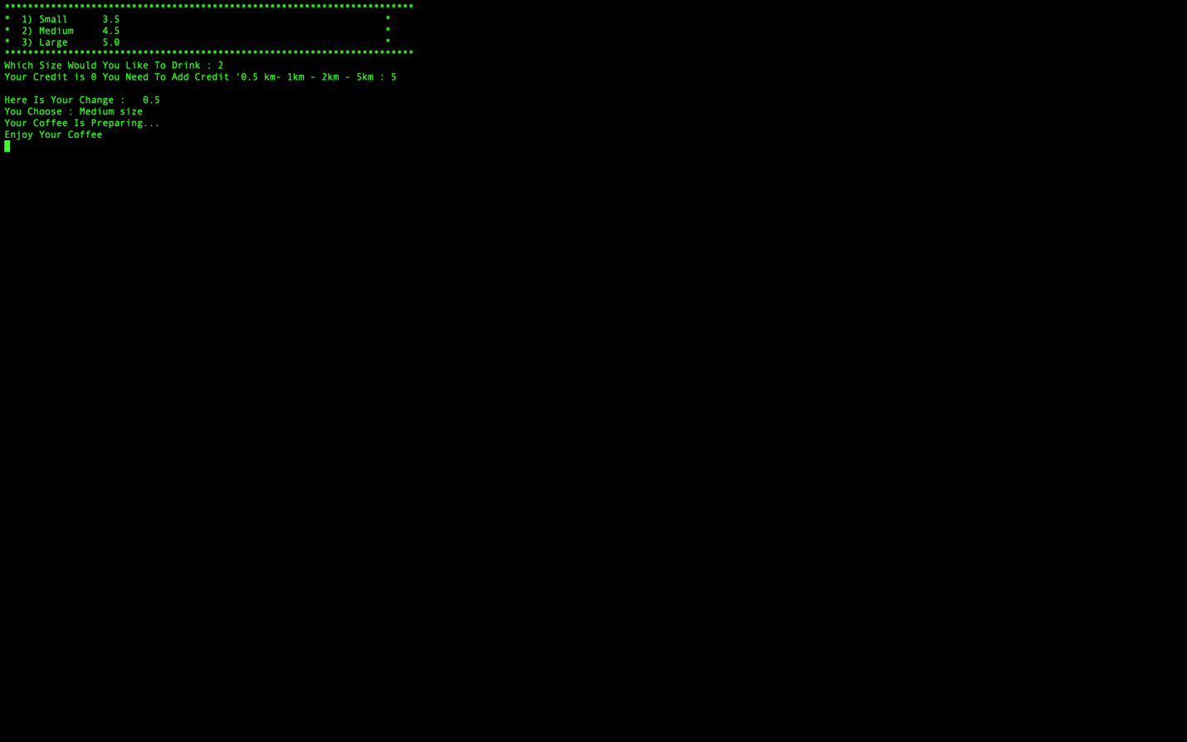
HOW DOES IT WORKS
Imagine that, the user adds 5 credits in order to take the Medium size of the hot chocolate the program shows
Here is your change
Preparing the coffee
Enjoy it
After that program returns to hot coffees menu

Slide 15

HOW DOES IT WORKS
And the final is exit what if the user wants to exit the program. In addition to that the user can exit from the program in three menus

Slide 16

WHAT WE LEARNED
How to use functions.
How to use and call the pointers inside of the functions.
How to communicate and work as a team.
How to call UNIX Library and use it inside of the development
Using loops inside of the functions (Do - While)
How to create an algorithm as a team project
How to convert C or C++ Script to C++ or C
Structure of C and C++ Programming Languages
How to Connect different C or C++ files with the system library.
We learned how to search, collect, and use the data from the internet and use these data inside of the script
How to find bugs and try to fix it

Slide 17

TASK DISTRIBUTION
Mustafa Bozteke: Convert C codes and functions to the C++ code functions in the project. In addition to that creating an algorithm with a team
Ozan Umut Guney: Worked as a tester and find the bugs in C and C++ . Also worked as a developer while developing to hot file in the project of the C part. In addition to that creating an algorithm with a team.
Talha Akyuzlu: Worked as a developer while developing to cold, exit, and main structure of the coffee part (coffee.c). In addition to that creating an algorithm with a team. In addition to that due to unexpected circumstances tried to code and convert the script from C to Octave but failed in octave.

Slide 18

WE TRIED TO DO OUR BEST ☺

